Slide 1


Modular LED Lamp
Andra Aedma
Piotr Rzeznik
Nils Petersen
Ritter Norbert
David González Alen

Slide 2
Summary
Indroduction
Objectives
Requirements
LED Lighting Solutions
Marketing
Eco-eficiency Measures for Sustainability
Ethical and Deontological Concerns
Project Development
Design/Logo
Future development

Slide 3
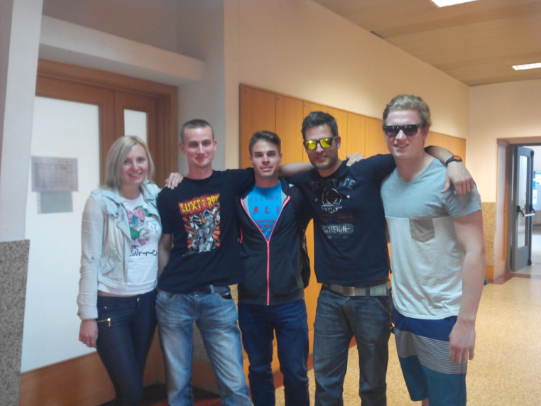
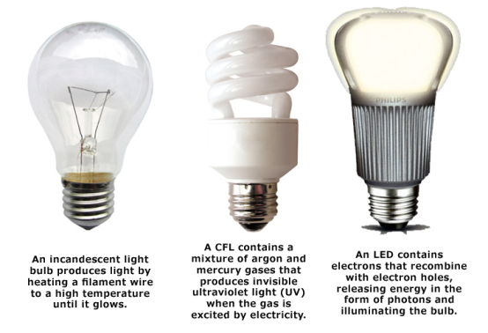
Introduction
Team (different backgrounds)
Motivation (choice)
Problem (nowaday´s lighting )

Slide 4

Objectives
LED lamp compatible with current lamps
Fitting universal sockets
Possibility of replacing only one LED
Low cost and long duration
Different colour tones to assemble environments where it will be used
Various geometry for different target markets

Slide 5
Requirements
Fitting universal lamp socket (E27)
Changing colors with remote control (radius 10 m)
Easy construction to change the LEDs
Including an automatic brightness control system (maximum radius 4.5 m)
Low cost and long duration

Slide 6

LED lighting solutions
Studying different LED types
Researching similar products
Comparing brightness control sensors (Laser and Ultrasonic sensor)
Comparing remote controls (IR, Wifi, Bluetooth)
Final conclusions

Slide 7
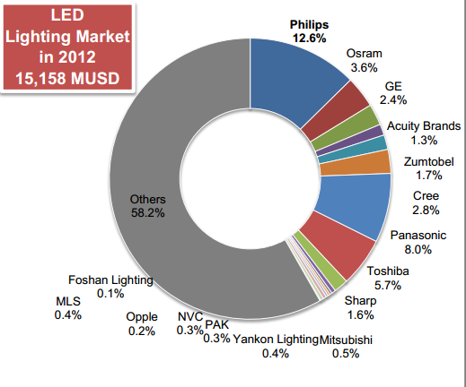
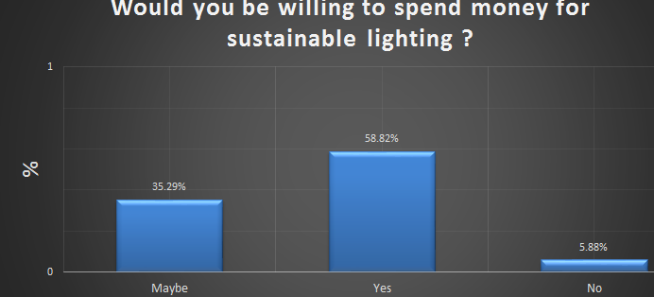
Marketing plan
Macro environment
Micro environment
Customer needs&desires
Target customer
Market research
Market survey

Slide 8
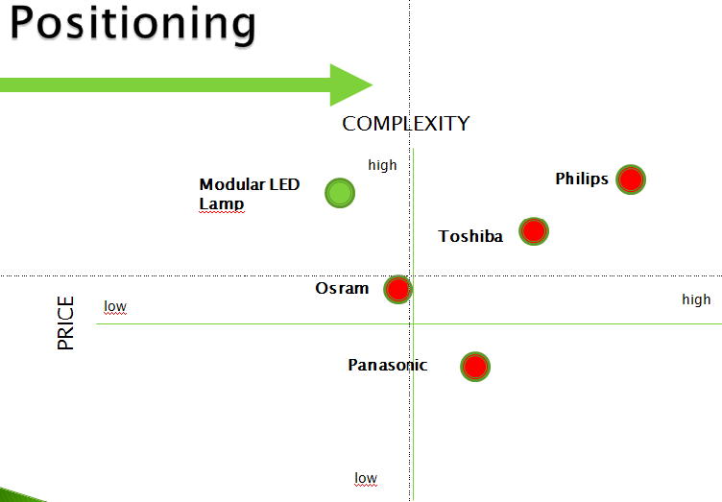
Marketing plan
Strenghts and Weaknesses
  Various skills, innovative team
  Lower price
  Less experience as competitors
  Limited financial methods
Market segmentation
  Catering, entertainment, accommodation, wellness, photography, stores
Positioning
  Based on survey and market review

Slide 9
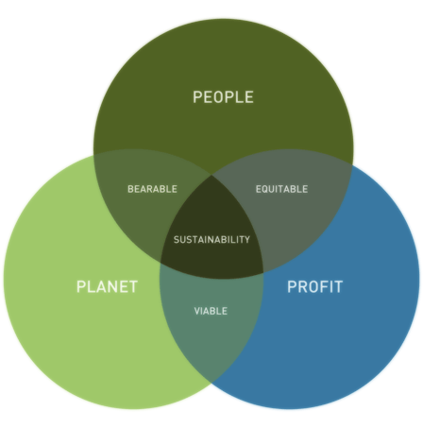
Eco-eficiency Measures for Sustainability
Environment
  Material (recycling, RoHS)
  Transportation (in bulk, buy local)
  Production equipment (new technology)
Social
  Fostering the local community (events supporting, local contractors)
  Customers well-being
  Employees healthcare and working conditions (continuous improvement)
  Corporate culture (transparency, equality, diversity, standards)

Slide 10

Ethical and Deontological Concerns
Engineering Ethics
  Main problems
  Code of ethics
Sales and Marketing Ethics
  Branding, trademarks
Academic Ethics
  Quotations
Environmental Ethics
  Responsibility
Liability
  Law restrictions

Slide 11
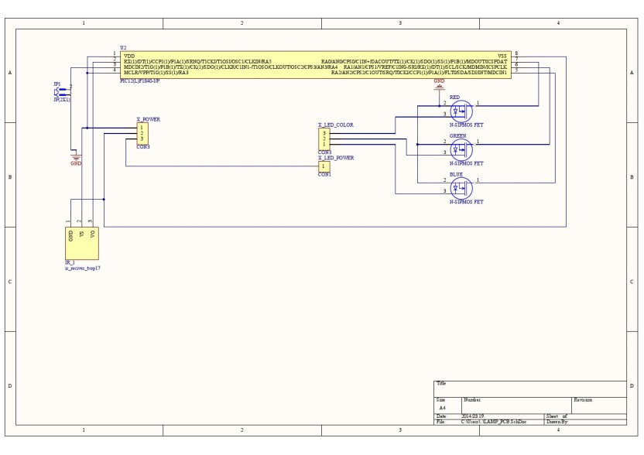
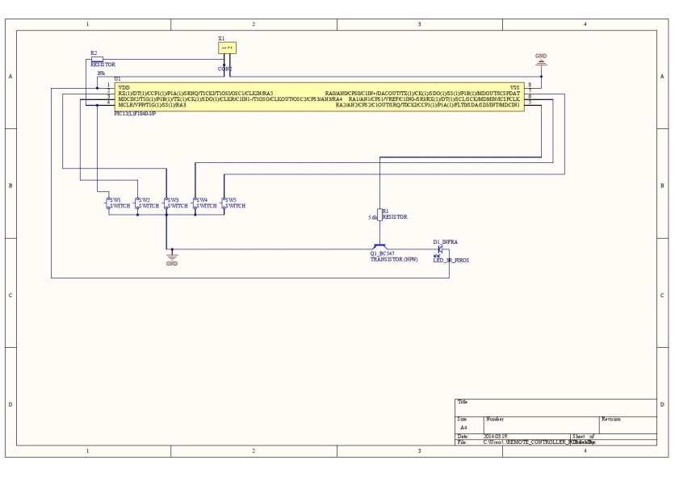
Project development
PCB LED driver
Remote control

Slide 12
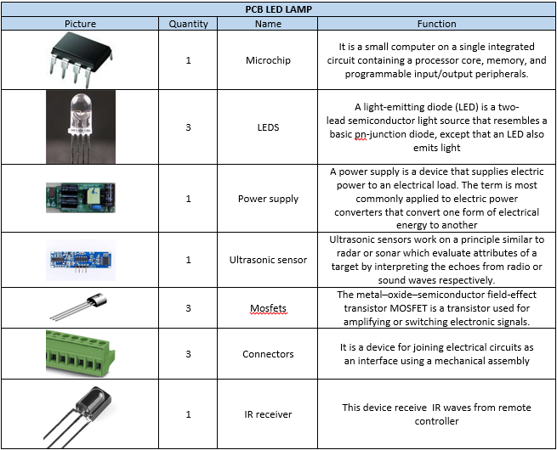
Components

Slide 13
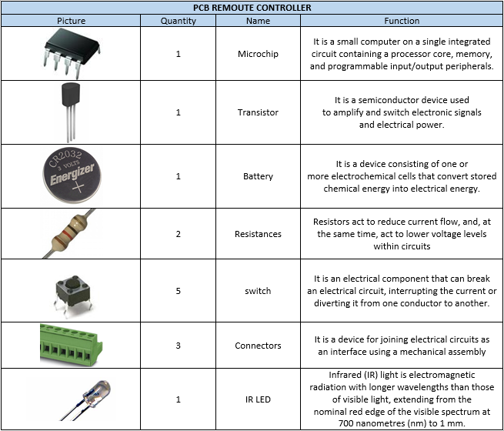
Components

Slide 14

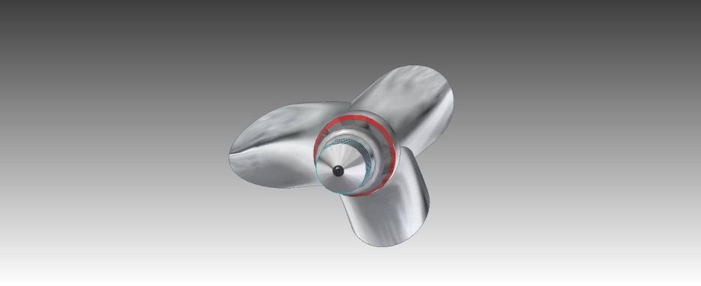
Design

Slide 15
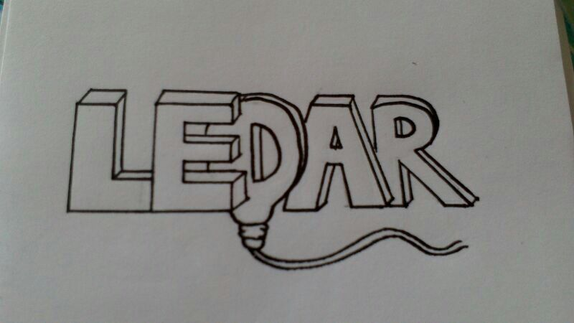

Brand, logo

Slide 16
Future Development
Developing our brand
  Website
  Final logo
  Poster, leaflet
Developing prototype
  Ordering materials
  Final design
User manual, video

Slide 17
Conclusion
Special requirements
Marketing plan
Eco-eficiency Measures for Sustainability
Ethical and Deontological Concerns
Initial design and logo
Future plans

Slide 18
Links
http://allenelectrical.com/wp-content/uploads/2012/11/light-bulb-types.jpeg
http://www.info-praxisteam.de/2009/01/11_1.jpg
http://physio-vision.de/layout/img/Maennchen_Gluehbirne.jpg
http://www.kalpaconsulting.com/images/3-rings-of-sustainability.gif
http://media.tumblr.com/tumblr_lsuke1qcQo1qd9o7r.png

Slide 19
Thank You for Listening!
Andra Aedma
Piotr Rzeznik
Nils Petersen
Ritter Norbert
David González Alen

