Slide 1

Modular LED Lamp
Team4
Piotr Rzeznik No. 1131616
Nils Petersen No. 1131566
David González Alen No. 1130909

Slide 2


Agenda
Introduction
    Team
    Problem
    Product
LED lighting solutions
Project development- design
    Electonic parts
    Tests
Achievements
Future development
Conclusions
Video
Notes:
Come me la polla

Slide 3
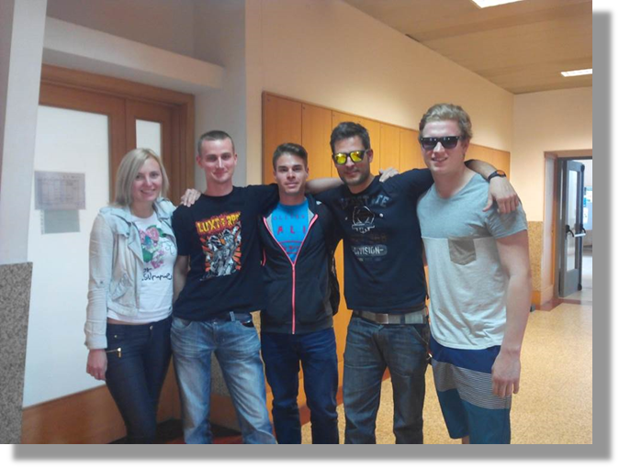
Team
Andra Aedma, Engineering materials and marketing
Nils Petersen, International sales and purchasing in engineering
Piotr Rzeznik, Logistics
Norbert Ritter, Electrical engineering
David González Alen, Electrical engineering

Slide 4


Lighting problems
Short lifetime
Inefficency
Toxic materials
Unrecycable construction
High energy cost

Slide 5
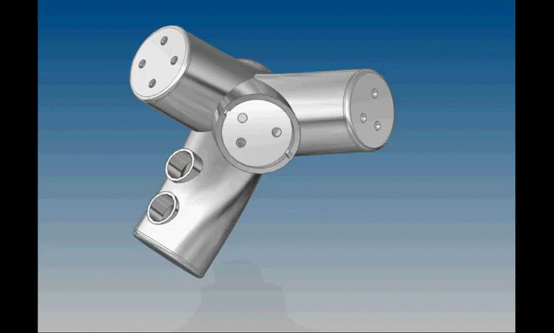
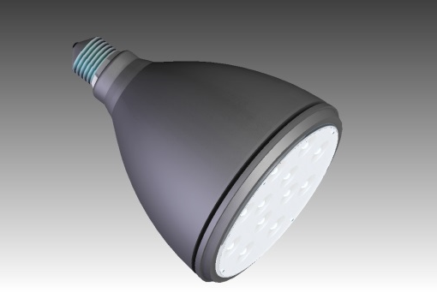
Product
Modular LED Lamp
  Fits to E27 lamp socket
  Changes colours
  IR remote control
  Automatic dimming system
  Reduce the energy intensity up to 10%
  Easy construction to replace the LED
Sustainable
Low cost

Slide 6

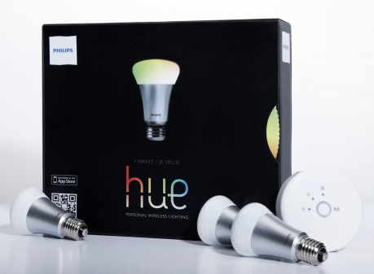
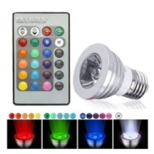
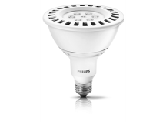
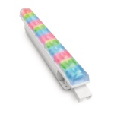
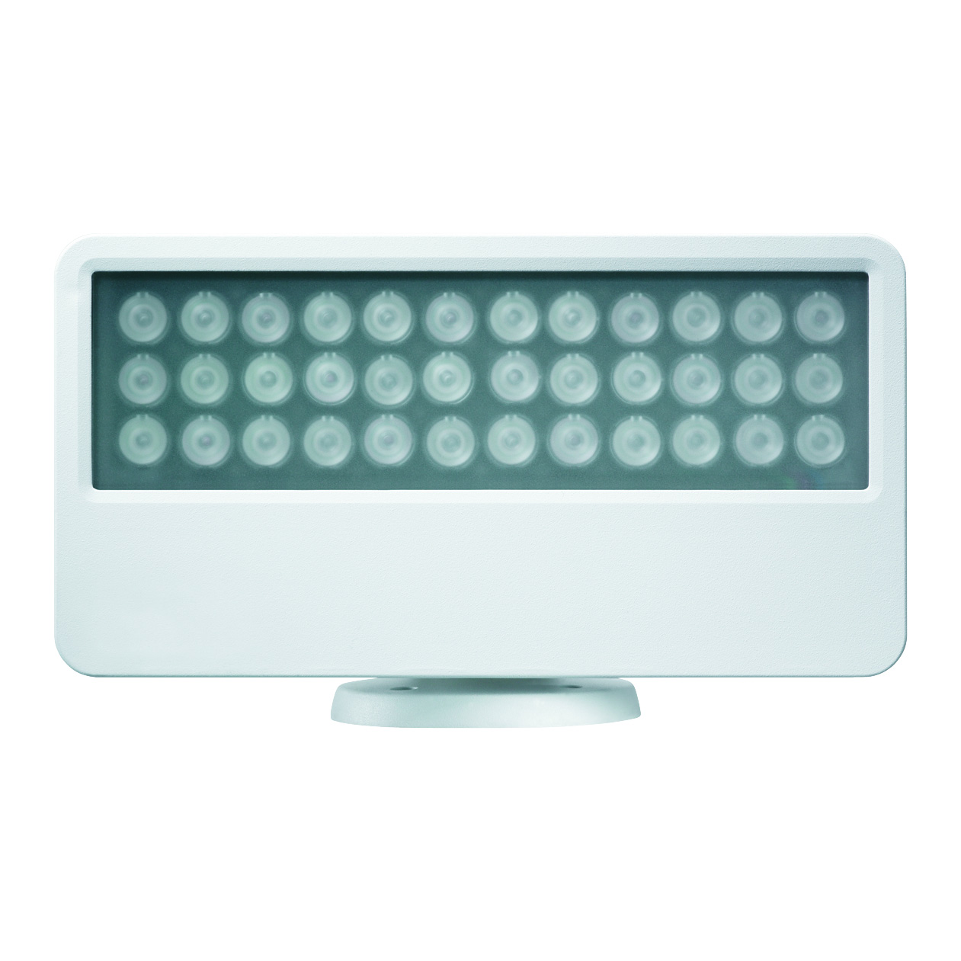
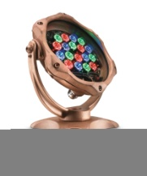
Competitors

Slide 7
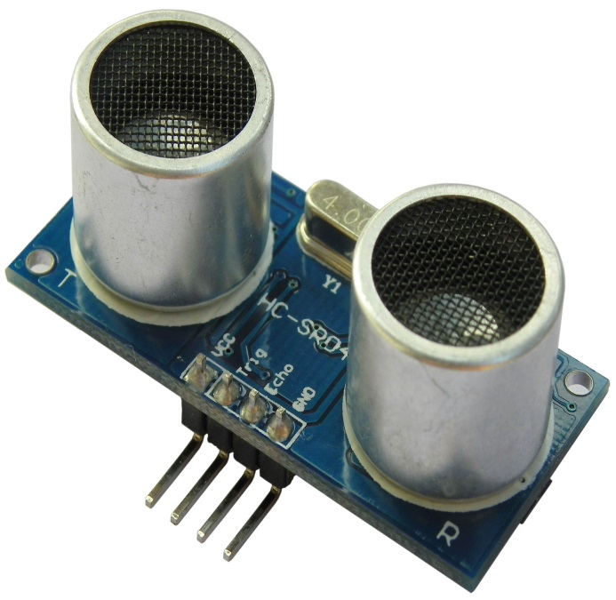
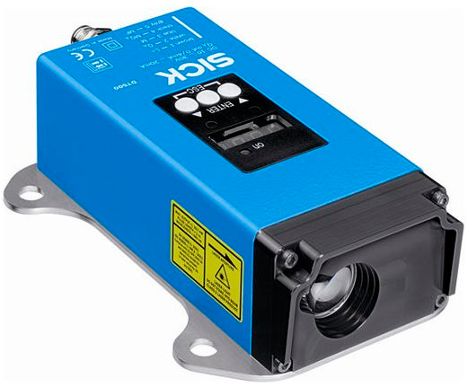
LED lighting solutions: Sensors
Ultrasounic sensor
Laser sensor

Slide 8



LED lighting solutions: Remote control
Wifi Bluetooth Infrared

Slide 9
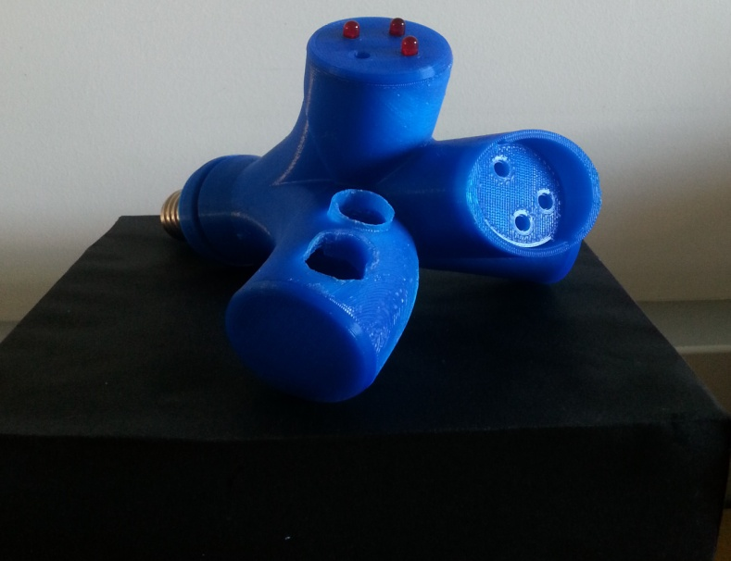
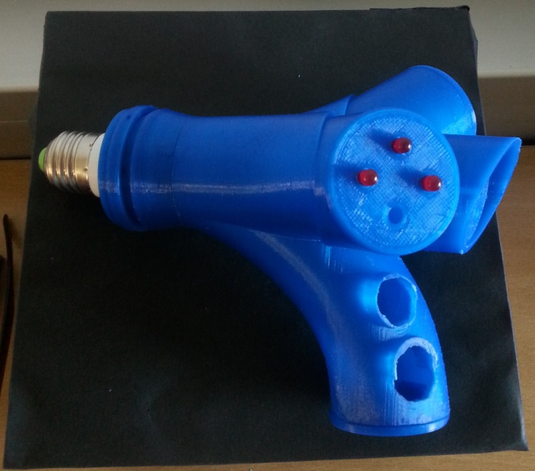
Design
Nature inspired
Fancier
3D printing
Blue polylactic acid

Slide 10
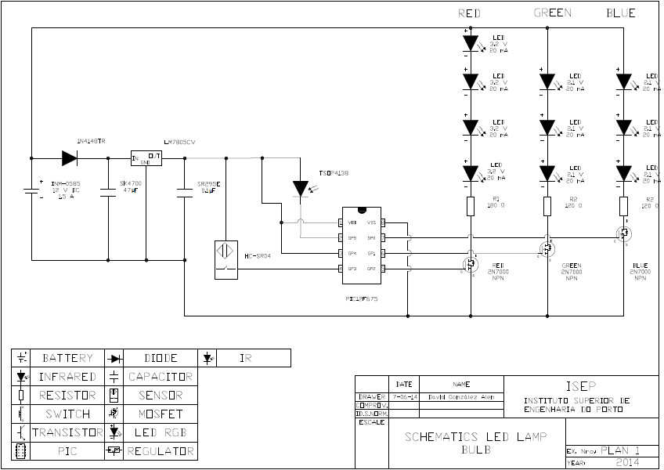
Project development: Electronic part
LED lamp scheme

Slide 11
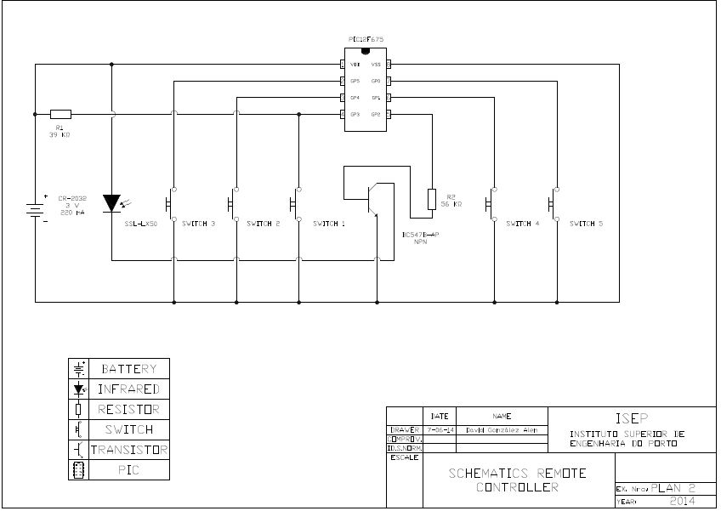
Project development: Electronic part
Remote control scheme

Slide 12
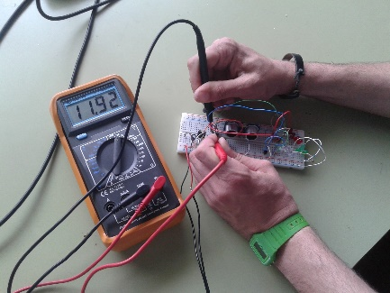
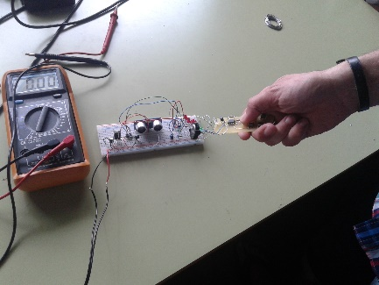
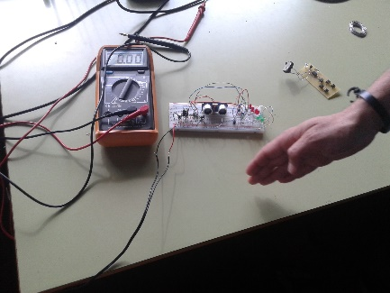
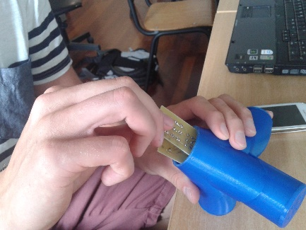
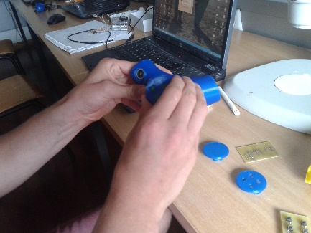
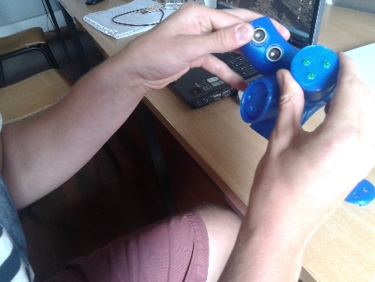
Tests
PCB
Remote control
Ultra sonic
Insert PCB
Insert LED
Insert Ultra sonic

Slide 13
Results
Product
  Received all materials
  Tried to assemble the LED
3D printed lamp bulb
  Need to improve in some parts
Developed a distribution packaging
Created a customer website

Slide 14
Future development
Building up a new prototype
Bluetooth remote control
  Creating an App
Decrease lamp size
Improve design for ultra sensor and PCB
Using flexible material

Slide 15
Conclusions
LEDAR LEADS YOU TO A GREENER FUTURE
Durability
Sustainable production system
More efficient in recycling
Mercury free
Saves energy with digital technologies
More features with less cost

Slide 16

Conclusion
Knowledge of LED lamp
Building up the lamp
Difficulties in teamwork
Difficulties in processing
Longer preparation period

Slide 17
Video
https://www.dropbox.com/s/gr4cpee01glecla/VIDEOv2.mpg

Slide 18

Thank you for attention!
Questions?
Piotr Rzeznik
Nils Petersen
David González Alen

Slide 19
References
http://www.ebay.com/sch/sis.html?_nkw=24%20Key%20IR%20Remote%20Control%2016%20Colors%20Changing%205050%203528%20SMD%20RGB%20LED%20Strip%20Colors&_itemId=111295784297
http://www.wifiledlamp.com/applamp-wifi-box-with-app-for-applamp-lighting.html
http://mobileworldz.blogspot.pt/2011/05/bluetooth-technology-is-not-suitable-wi.html
http://en.wikipedia.org/wiki/Ultrasonic_sensor
http://www.ifm.com/ifmaus/web/pinfo010_070_040.htm

