Slide 1
Reconfigurable LED Lamp
Andra Aedma
Piotr Rzeznik
Nils Petersen
Ritter Norbert
David González [POL]

Slide 2
Why we choose…

Slide 3

We have three possibilities for remote control

Slide 4
Type of controller | Advantages | Disadvantages
IR | Easy function Cheap Simplicity Easy for buy a new controller | Distance to use only 10 m Can’t create scenes
WIFI | You can controller 5 lamps 20 meters through walls | Needs all time your smartphone Not working WI-FI Needs router
Bluetooth | Control of multiple lights Automatically switches the light on/off to deter intruders. | Needs iOS don’t run with Android. You need have open the App always

Slide 5
We choose the IR control because it's easy for controller, and accessible for all public
You would controller with remote control all lamps only by one, because all devices used the same communication protocol. The maximum distance for use is the 10 m.
If you want install this led lamp in your home or in your business like for example restaurants, bar, shops... you don't need your mobile phone and neither WI-FI.
Imagine be work with a mobile phone in a pocket all journey.
This is the same at home, for example young people have WI-FI and smart phone we can controller by WIFI or Bluetooth, well if you have an iPhone but what happen if you have Android you must buy an iPhone?
If you are grandparents and you want to buy a LED light for grandson or granddaughter?
We conclude that this controller is the most accessible for all publics and cheaper among 3 types by functionality and simplicity

Slide 6

At the end we choose IR CONTROL

Slide 7
Brightness controller
TWO POSSIBILITIES:
Ultrasonic sensor
Laser sensor

Slide 8
Brightness control sensors
Product | Advantages | Disadvatages
Ultrasonic sensor | -An ultrasonic sensor’s response is not dependent upon the surface color or optical reflectivity of the object; -Ultrasonic sensors with digital (ON/OFF) outputs have excellent repeat sensing accuracy, it is possible to ignore immediate background objects, even at long sensing distances because switching hysteresis is relatively low; -The response of analog ultrasonic sensors is linear with distance, by interfacing the sensor to an LED display, it is possible to have a visual indication of target distance - this makes ultrasonic sensors ideal for level monitoring or linear motion monitoring applications; -Cheap (0,96 €); - Small | -Ultrasonic sensors must view a surface (especially a hard, flat surface) squarely (perpendicularly) to receive ample sound echo; -While ultrasonics exhibit good immunity to background noise, these sensors are still likely to falsely respond to some loud noises, like the “hissing” sound produced by air hoses and relief valves; -Ultrasonic sensors have a minimum sensing distance; -Changes in the environment, such as temperature, pressure, humidity, air turbulence, and airborne particles affect ultrasonic response

Slide 9
Brightness control sensors
Product | Advantage | Disadvanatge
Laser sensor | -Distance measure at light speed (depends on the processor speed also); -Ideal for near real time positioning of an object | -Depends on weather; -Visual path should be clear; -Dusty air, rainy or cloudy day will effect the accuracy or even unusable; -Expensive (100€); -Big

Slide 10
We choosed ultrasonic sensor

Slide 11

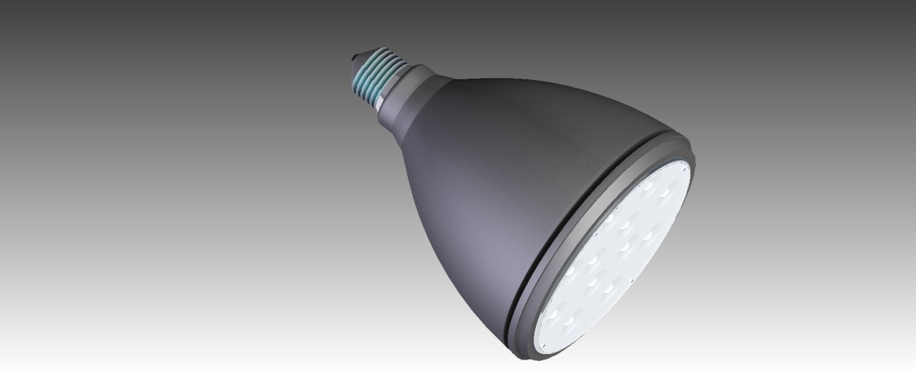
Initial desing for light bulb

Slide 12
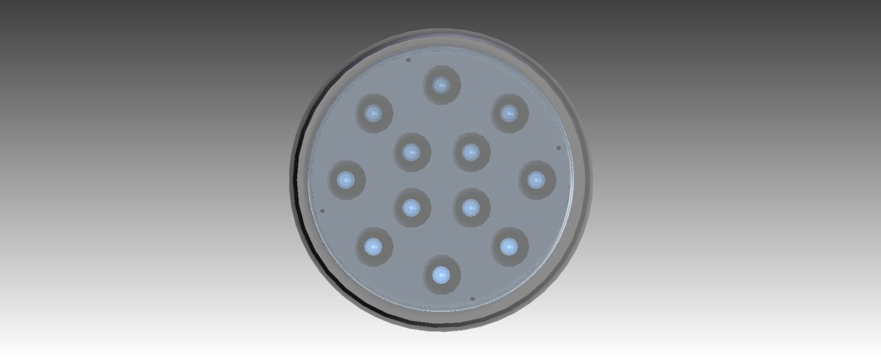
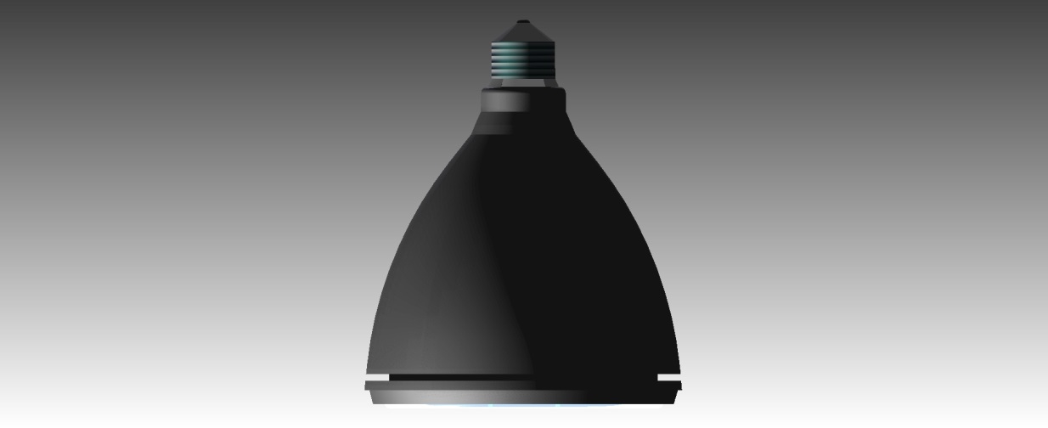
Initial design for light bulb

Slide 13
THANK YOU FOR LISTENING!
TEAM 4

